Slide 1

Robotics + 3D Vision: Eye-Brain-Hand System
yanheling@chuangxin.com

Slide 2
Human Eye-Brain-Hand System
• A majority of human tasks can be summarized as eye-brain-hand coordination
• Two cortical systems exist, providing: `vision for action` and `vision for perception`
dorsal stream
Where
ventral stream
What
v1: absolute disparity
v2: relative dispartiy
v4: relative dispartiy
v5: relative disparity
Reading Materials:
binocular neurons
Two-streams hypothesisre-viewed

Slide 3
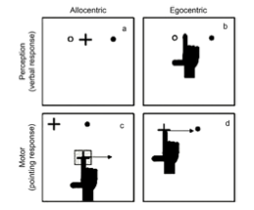
Human Eye-Brain-Hand System
vision for action vs. vision for perception
allocentric vs. egocentric
Factor | Ventral system | Dorsal system
Function | Recognition/identification | Visually guided behavior
Sensitivity | High spatial frequencies - details | High temporal frequencies - motion
Memory | Long term stored representations | Only very short-term storage
Speed | Relatively slow | Relatively fast
Consciousness | Typically high | Typically low
Frame of reference | Allocentric or object-centered | Egocentric or viewer-centered
Visual input | Mainly foveal or parafoveal | Across retina
Monocular vision | Generally reasonably small effects | Often large effects e.g. motion parallax
Reading Materials:
patient D.F. with grip aperture
Two visual systems.
Neural science of vision

Slide 4
From Neural Science to Artificial Intelligence
From a engineering perspective, what works is ultimately all that matters.
For the purposes then, biological plausibility is a guide, not a strict requirement.
Example – From Animal Navigation to Autonomous Driving
Mammals + Birds | Cognitive map – Relocalization
 | Vision Tracking – Somato Sensory
 | Collision Avoidance – Local Planning - Simulation Based Planning
Migrant Bird | Sun – Inner Clock - Direction
Mole | Magnetic Filed – Somato Sensory
Human | Reason-Direction
Reading Materials:
Neural Sicene Inspired Artificial Intelligence
Grid-like Representations Agents

Slide 5
A Reference Task for AI: Grab Something onto Something

Slide 6
A Reference Task for AI: Grab Something onto Something
A clear definition of a target is NOT at ALL a clear definition of a task
Do we have the 3D map or not?
Target platform fixed or not?
Obstacle move or not?
Camera move or not?
DOF of robotic?
Object hard or soft?

Slide 7
A Reference Task for AI: Grab Something onto Something
Task: put something on the target plane
This is the target
This is the plane

Slide 8
A Reference Task for AI: Grab Something onto Something
Moving object
Moving obstacle

Slide 9
Reference Architecture
Depth Camera
Object Recognition
3D Vision
3D Meshing (single frame)
Geometry recognition
Depth Processing
Extrinsic Calibration
Simulation
Planning
Arm Simulation
3D World Simulation
Physical Engine
Motion Control

Slide 10
Depth Camera Overview
Depth Camera
Triangulation
Time
Stereo
Structured Light
Direct TOF
Phase Detection
Active
Passive
Single
Frame
Multi
Frame

Slide 11
3D Vision: An Example
Geometry Recognition
for i in max_iteration
random pick 3 points
fit a plane by 3 points
for j in num_of_point
if inlier
Num_inlier ++
if Num_inlier > max_Num_inlier
max_Num_inlier = Num_inlier
A, B, C = plane_param

Slide 12
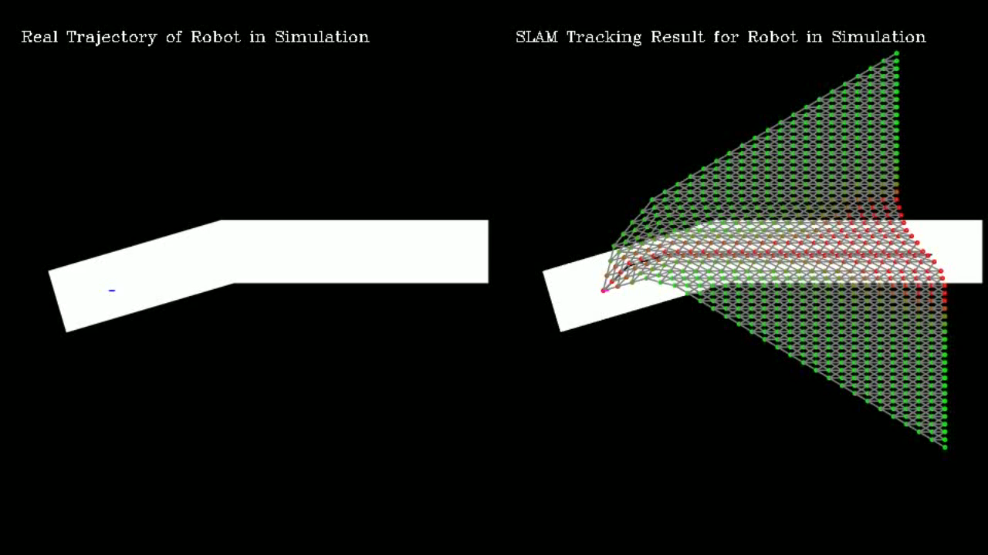
Planning: An Example
Motion planning under biased tracking

Slide 13
Extrinsic Calibration
Solve by Levenberg-Marguardt Method or
opencv::solvePnP
Reading Materials:
Multiview-Geometry-3D vision

Slide 14
Why Simulation?
For dynamical problem, an observation of state, is a result of action.
Q – Learning
Initialize Q-values (Q(s,a)) arbitarily for all state-action pairs.
For life or until learning is stopped
choose an action a in the current world state s based on current Q(s,a)
take the action a and observe the outcome state s’ and reward r
update Q(s, a) = Q(s, a) + 𝛼[r + 𝛾*maxQ(s’, a’) – Q(s, a)]
a2
a4
a1
a3
s1
s2
s3
s4
s5
Reading Materials:
Deep-Q-Learning

Slide 15
Proposed Deecamp Time Line
 | ww01 | ww02 | ww03
2D detection (0-1person) | done | NA | NA
system ramp-up (all) | done | NA | assemble
calibration (1 person) | manual calibration | calibration pipeline | calibration finetune
planning (1-2 person) | study motor control | 2D+ planning | 3D planning
3D vision (1-2 person) | get to know 3d camera | mesh building | plane fitting
production design(1-2 person) | demo design | proto-type design | show-case

